Slide 1
Contact Roles
13 February 2014
Notes:
Guidewire training materials contain Guidewire proprietary information that is subject to confidentiality and non-disclosure agreements. You agree to use the information in this manual solely for the purpose of training to implement Guidewire software solutions. You also agree not to disclose the information in this manual to third parties or copy this manual without prior written consent from Guidewire. Guidewire training may be given only by Guidewire employees or certified Guidewire partners under the appropriate agreement with Guidewire.

Slide 2
Lesson objectives
By the end of this lesson, you should be able to:
Describe the ways in which contacts are categorized
Describe and configure contact roles
Configure contact role type constraints
Configure entity role constraints
This lesson uses the notes section for additional explanation and information. To view the notes in PowerPoint, choose View→Normal or View→Notes Page. If you choose to print the notes for the lesson, be sure to select “Print hidden slides.”

Slide 3
Lesson outline
Contact basics
Contact roles
Categorizing contact
Contact role configuration
Contact role type constraints
Entity role constraints

Slide 4
Contacts
Contact
Claimant
Reporter
Auto Repair Shop
Hospital
Court
A contact is a person, organization, or venue which is related to the claim, such as...
Someone who suffered a loss
Some company or vendor which repaired a damaged asset
Some place where disputes were resolved
Notes:
A venue is a location for a scheduled event relevant to claims processing. Typically, venues are places where dispute resolution occurs, such as a courthouse or a conference room used for arbitration.

Slide 5
The contact subtype hierarchy
Contact
the primary subtypes
Person
Company
Place
Person Vendor
Adjudi- cator
Company Vendor
Legal Venue
searches at this level return doctors and attorneys
Law Firm
Attorney
Medical Care Org
searches at this level return only doctors
Doctor
Auto Towing
Auto Repair
Notes:
Contacts within ClaimCenter are organized into a specific subtype hierarchy. The organization of the hierarchy helps to specify and enable certain types of functionality. For example:
The hierarchy helps to define the sorts of searches users can do. You can easily configure search screens for any node in the hierarchy. The search results will include matching contacts at or below that node. In the example above, a user could do a search for attorneys (which will return just attorneys), or for doctors (which will return just doctors), or for person vendors (which will return both attorneys and doctors, but not law firms or medical care organizations because they are not underneath the "Person Vendor" node of the hierarchy).
The hierarchy helps to define the criteria for identifying two objects as possible matches. For example, if the matching logic for law firms, medical care organizations, auto towing and auto repair shops is identical (the tax ID for the two objects must match), then this logic can be specified at the Company Vendor level.
There are three primary subtypes in the contact subtype hierarchy: person, company, and place. Below these three primary subtypes are several “child” subtypes. It is recommended that no new subtypes should be created. However, customization such as adding properties/fields is acceptable. Instead of creating new subtypes, use other configuration capabilities in ClaimCenter such as adding new contact roles, configuring contact tags (in ContactManager), or configuring the list of vendor services provided (for example, adding services under a category of “Landscaping” (lawn repair, tree repair, gardening, etc.)). That way, a new subtype of vendor such as “Landscaping Vendor” is not needed. Contact role configuration is discussed in this lesson. Configuring contact tags is discussed in the ContactManager 8.0 Configuration for ClaimCenter 8.0 training course. Configuring vendor services is discussed in the ClaimCenter 8.0 New Configuration Features training course.
An adjudicator is not a claims adjuster. An adjudicator is a judge or arbitrator as a type of Person. An adjudicator may have a specific adjudicative domain.

Slide 6


Two applications store contacts
Address Book
Contact
Manager
contacts relevant to a single claim
contacts relevant to multiple claims
Two applications store contacts
ClaimCenter stores contact information as it pertains to a given claim
Address Book stores contacts that are (potentially) relevant to multiple claims
Notes:
Most carriers with claims processing systems have a contact management application, which is often referred to in the industry as the "address book".
ClaimCenter comes with a separate contact management application called ContactManager. ClaimCenter and ContactManager are integrated, and most of the functionality belonging to ContactManager appears seamlessly in ClaimCenter. The ContactManager application functionality is typically referenced within ClaimCenter using the term "Address Book".
This course uses the term "Address Book" to reference functionality found in ContactManager, or potentially in a different contact management application.
The topic of how vendor contacts are synced and configured is discussed in detail in ClaimCenter 7.0-8.0 New Configuration Features course.

Slide 7
“Local” contacts
Address Book
Claim 000-00-002006
Doris Schwartz (witness)
Typically a non-vendor, non-venue contact, such as the insured, a claimant, or a witness
Notes:
A ClaimCenter contact may exist only in ClaimCenter (and not in Address Book). This is typical when the contact is not expected to be used for any other claim (such as a witness or a third-party claimant), which is typically true for a contact which is not a vendor or a venue. There is no need for contact information to be shared across multiple claims, so the contact is not stored in the address book. This is also known as a “local” contact (local to ClaimCenter).

Slide 8
“Shared” contacts
Address Book
Claim 000-00-002006
ContactManager
Dr. Matt Sawyer (1)
Claim 036-22-934712
Dr. Matt Sawyer (AB)
Dr. Matt Sawyer (2)
Claim 908-00-230166
Typically a vendor (or venue)
Dr. Matt Sawyer (3)
Notes:
A ClaimCenter contact may also exist in the address book. This is typical when the contact is used or is expected to be used for multiple claims. This is typically true for person vendors such as doctors, company vendors such as hospitals, or venues such as courts. Theoretically, it could also include a policy holder with a large number of potential claims, such as a large business with a workers' comp policy. Because there is a need for contact information to be shared across multiple claims, the contact is stored in the address book. (In the diagram above, the "AB" after the Address Book Matt Sawyer stands for "address book".)

Slide 9
Shared contacts are typically "linked"
Address Book
in sync
ContactManager
Dr. Matt Sawyer (1) phone: 324-6600
out of sync
Dr. Matt Sawyer (AB) phone: 324-6600
Dr. Matt Sawyer (2) phone: 453-2331
in sync
Dr. Matt Sawyer (3) phone: 324-6600
Notes:
When a contact exists in both ClaimCenter and the address book, every copy of the contact is a unique (but potentially related) object. Notice that there are four Matt Sawyer objects. The Address Book version is suffixed with "AB". All the other version are suffixed with a distinct integer. Even though they all represent the same person, they are four distinct objects.
When a contact exists in both ClaimCenter and Address Book, it can be linked (and most likely is). When a contact is linked:
The ClaimCenter user interface identifies that the contact is linked.
The ClaimCenter user interface identifies when a contact's information is not identical to the corresponding Address Book object. This is referred to as being "out of sync". (Although it is likely that the majority of the fields will store the same data, it is possible for individual fields to differ from one related contact to the next. For example, the phone number for Matt Sawyer (2) is different than the phone number for all the other Matt Sawyer objects.)
A user can recopy the information from the Address Book object to the ClaimCenter object. This is referred to as "syncing the contact".
In ClaimCenter, a user can search for contacts in the Address Book and then view what claims the contact is involved in (using a card that shows all related claims). For example, you can search for “Matt Sawyer” using the Address Book tab. The contact used for the search criteria exists in Address Book, but the claims returned from the search come from ClaimCenter.
(continued)

Slide 10
(Notes only slide)
Notes:
Even if two objects are linked, modifications to one of the objects are not inherently replicated to the other linked objects. For example, a change made to the object in ClaimCenter is not inherently copied to the address book, and a change made to the object in the address book is not inherently copied to all instances of the claim in ClaimCenter. However, a user can "sync" objects, which copies the information from the Address Book to the ClaimCenter object.

Slide 11
Lesson outline
Contact basics
Contact roles
Categorizing contact
Contact role configuration
Contact role type constraints
Entity role constraints

Slide 12
Contact roles
Auto Claim 036-22-934712
Workers' Comp Claim 772-12-9000
OmniTech Inc. - Insured (policy)
Ellen Lopez - Insured (policy) - Reporter (entire claim) - Claimant (exposure 1)
Tommy Duke - Claimant (exposure 1)
Matt Sawyer - Doctor (entire claim)
Matt Sawyer - Doctor (entire claim)
Notes:
Whenever a contact is associated to a claim, the contact has one or more roles on the claim. Each role identifies a relationship between the contact and the claim. Each role can be “related to” the claim or one of its parts. This relationship designates if the contact has this role for the entire claim, for the policy, for a specific exposure, or for a specific incident.
Keep in mind that every contact object in ClaimCenter is unique. It is possible for a single person to be a contact on multiple claims. (In the example above, Matt Sawyer is a doctor for the auto claim and the workers' comp claim.) In this case, there are two unique objects corresponding to the same person. Fields within one object may have the same values as or different values than the corresponding fields in the other object. For example, Matt Sawyer's address may be the same in both contact objects, but his "okay to contact" field may be different. (It could be okay to contact him for the workers' comp claim but not okay to contact him for the auto claim.)
(continued)

Slide 13
(Notes only slide)
Notes:
ClaimCenter has a "role constraint" feature which adds additional business logic around contact roles. Role constraints can be used to:
Identify which contact subtypes can hold a given role (such as a contact must be of subtype "person vendor" to hold to role of inspector")
Identify if there must be a contact on the claim with a given role (such as every claim must have a "reporter" and at least one "claimant")
Identify the cardinality of the claim to the role (which identifies if there can only be one contact with that role for a given claim, such as "reporter", or whether there can be many contacts with that role for a given claim, such as "claimants")
Identify whether a contact with a given role can be related to a given entity (such as the role of "driver", which can be related to a vehicle but cannot be related to an exposure)

Slide 14
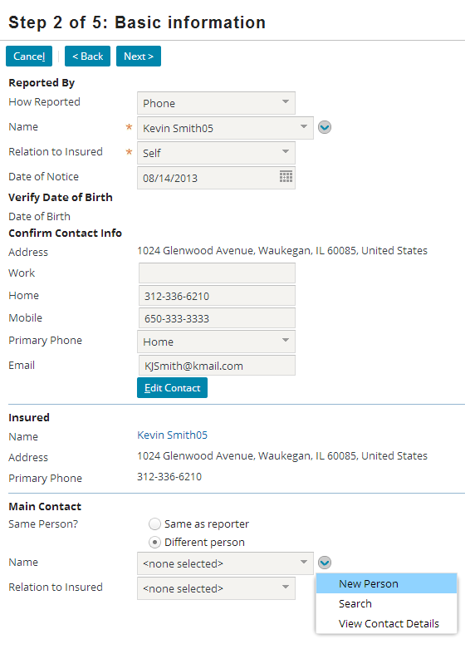
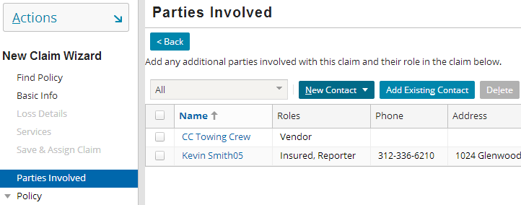
Creating contacts from the new claim wizard
Contacts added on the Basic Information step have a pre-defined role
Contacts added on the Parties involved step can have any role
Notes:
During the New Claim wizard, you can add contacts to a claim at multiple points, including the Basic Information step and the Parties Involved step.
In some places, such as the Basic Information step, a given contact has a pre-defined role. For example, the contact specified in the Reported By section has the role "reporter". The contact specified in the Main Contact section has the role "main contact".
In some places, such as the Parties Involved step, a given contact can have any role. For example, a contact added here could be "insured", "witness", "doctor" and so on.

Slide 15
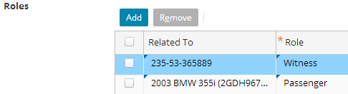
Roles in the User Interface
Claim 235-53-373872
witness
Helen Nixon
passenger
Incident 2003 BMW 355i
(entire claim)
Notes:
Recall that a contact may have more than one role and that each role is held in relation to the entire claim or to a specific exposure, incident, or policy.
The default relationship for each role is the entire claim, which appears in the Owner dropdown as the claim number.
In the example above, Helen Nixon:
Has the role of witness for the entire claim.
Has the role of passenger only for the 2003 BMW 355i incident.

Slide 16
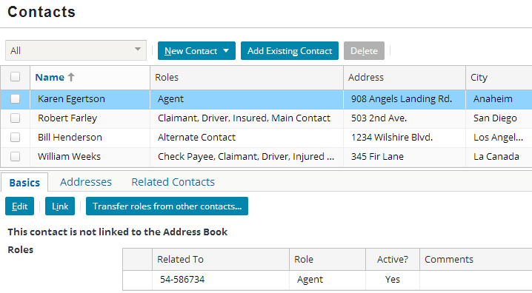
Transferring roles on a claim
Transfer roles from other contacts… button initiates process to move roles from multiple contacts into one (surviving) contact
Contacts whose roles are transferred (chosen on next screen) will be removed
Notes:
When a given contact is selected, you can find the Transfer roles from other contacts… button on the Basics card for that contact.
This button takes you to a popup where you can decide what other contact(s)’ roles to transfer to this contact.
This contact (the "survivor") remains on the claim and inherits all roles of the other selected contacts. The other selected contacts are then removed from the claim.

Slide 17
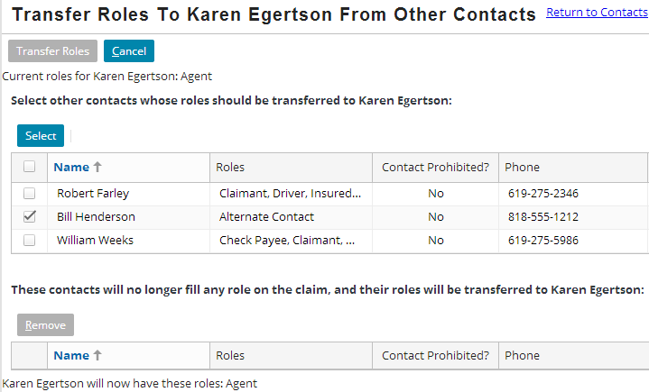
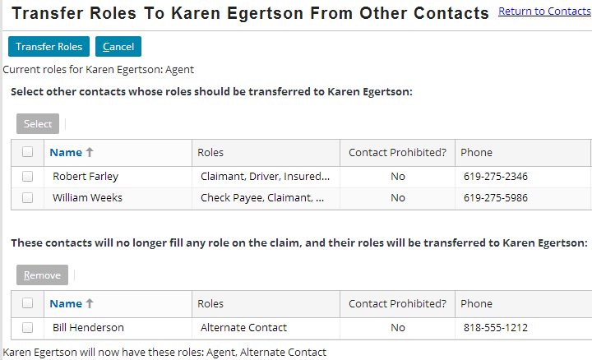
Transferring roles screen
Select contacts to merge into survivor
Selected contacts moved to “to be removed” list view
List of roles for survivor updated
Notes:
Select the checkboxes for one or more other contacts by checking the checkboxes. These contacts will be removed from the claim, and their roles added to the surviving contact.
Click Select. The contacts selected in step 1 are moves to a “to be removed” list view, and all roles from these contacts are added to the new list of roles for the surviving contact.
Note that the title of this screen highlights the name of the surviving contact.

Slide 18

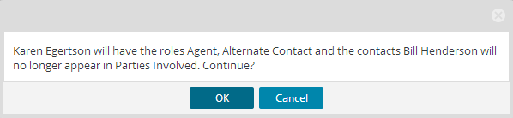
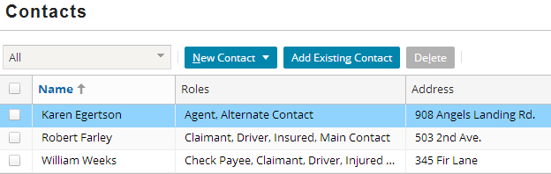
Transfer the roles
Click Transfer Roles to perform transfer
ClaimCenter displays final message detailing roles survivor will have, and contacts to be removed from claim
Can only transfer if survivor allowed to have all selected roles

Slide 19
Lesson outline
Contact basics
Contact roles
Categorizing contact
Contact role configuration
Contact role type constraints
Entity role constraints

Slide 20
Contact categorization
By Subtype
By Role
Contact
with role "reporter"
Company
with role "claimant"
with role "driver"
Auto Towing
Auto Repair
Contact objects are categorized in two ways
By subtype
By role
Each categorization offers different functionality and involves different types of configuration

Slide 21
Categorization by subtype
Contact
Primary Address Primary Phone
Primary Address Primary Phone Employees
Company
Primary Address Primary Phone Employees AutoTowLicense
Primary Address Primary Phone Employees AutoRepairLicense
Auto Towing
Auto Repair
Contact entity is subtyped
Fields inherited in hierarchical manner
Mirrors behavior of contacts in real world
Subtype categories reflect data gathered about a contact

Slide 22
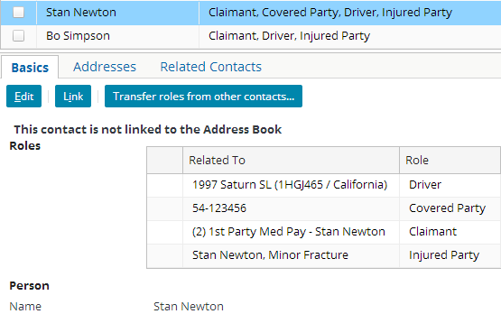
Categorization by role
Role describes relationship between contact and claim
Each contact must have at least one role
Each role is "owned by" entire claim or one of its sub-objects (policy, exposure, incident, and so on)
Notes:
Role configuration involves specifying how roles and the "Related To" entities interact
For example, a claim must have exactly one reporter and can have zero to many claimants

Slide 23
The contact role data model
Claim
Contacts
Stores fundamental information about contact
Links contact to a claim and its role(s) on the claim
ClaimContact
Contact
Person
Company
Venue
Roles
ClaimContact RoleOwner
ClaimContact Role
For each role, identifies owner (claim or subobject)
Identifies role(s) contact has on claim
Notes:
In the base application, matters and evaluations can also be role owners. (For example, a contact could be the "assessor" for an evaluation or the "primary defense attorney" for a matter.)
Claim.RoleOwners is an array of all Role Owners.
Categorization "by subtype" occurs within the Contact entity. When a contact is created, it is created as one of the subtypes, which in turn categorizes the kind of contact it is.
Categorization "by role" occurs within the ClaimContactRole and ClaimContactRoleOwner entities. When a contact is associated with a claim, it must have at least one role (which is linked to the contact through the ClaimContact entity), and this role has a role owner (the entity for which the contact's role is relevant).

Slide 24
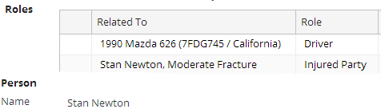
The contact data model in the UI
ClaimContact
Contact
Person
Company
Venue
ClaimContact RoleOwner
ClaimContact Role
Notes:
The example above is a visual illustration of the four main entities in the "contact data model".
The base contact information is stored inside one of the subtypes of contact.
The contact has one or more roles on the claim. These are stored in ClaimContactRole objects and appear in the user interface in the Role column of the Roles list. Note that the relationship between ClaimContact and ClaimContactRole is one-to-many, which manifests itself in the user interface as a single contact with a list of one to many roles.
Each role that the contact holds has a "Related To" entity, also known as the role owner. These are stored in ClaimContactRoleOwner objects and appear in the user interface in the Related To column of the Roles list. Note that the relationship between ClaimContactRole and ClaimContactRoleOwner is one-to-one. Each role is owned by only one object.
Finally, the ClaimContact object links all of the information together and attaches it to the claim.

Slide 25
Intersection of roles and subtypes
Doctor
Person
role: primary doctor
role: primary doctor
Doctor
Company
role: physical therapist
role: primary doctor
Two contacts of the same subtype could exist on the same claim with different roles (and this is quite common)
Typically, two contacts of different subtypes cannot have the same role
Notes:
Roles and subtypes classify contacts in different ways. This raises the question of whether or not you can have two contacts which have the same subtype but different roles and vice versa.
It is common for two contacts to have the same subtype but different roles. For example, two contacts of subtype Doctor could be associated with a claim, one with the role of primary doctor, the other with physical therapist. (This could occur if a claim involved an injury in which the primary doctor referred the injured party to a physical therapist.)
As a general practice, each role can only be assigned to contacts of a single subtype. Therefore, it is rare to have two contacts of different subtype with the same role. (The one exception to this in the base application is the role "claimant". A "claimant" is always of subtype person, except when it is on an exposure, in which case it can also be of subtype company. So a claimant must be either a Person or, if being assigned to an exposure, a Person or Company.)
One thing to keep in mind is that a contact has a subtype inherently, but a contact has a role only with relationship to a given claim. A contact of subtype adjudicator is always of subtype adjudicator, regardless of the claims it may or may not be associated to. A contact with role "arbitrator" on a given claim is (potentially) an arbitrator only for that claim and only by virtue of being associated with that claim.

Slide 26
Lesson outline
Contact basics
Contact roles
Categorizing contact
Contact role configuration
Contact role type constraints
Entity role constraints

Slide 27
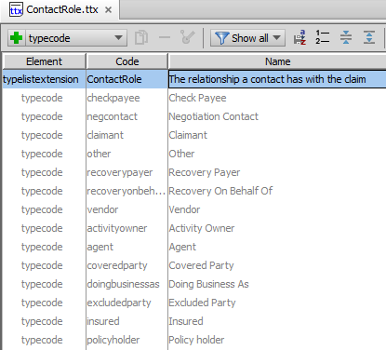
Contact roles
The ContactRole typelist lists all contact roles
To create a new role, add a typecode to the typelist

Slide 28
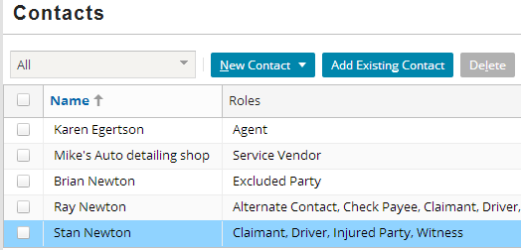
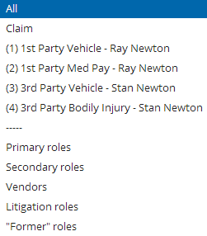
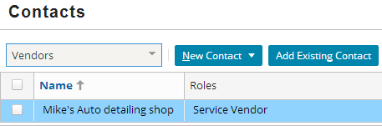
The contacts list view filter
entity filtering
contact role category filtering
Notes:
The contacts list view has a filter in the toolbar that can be used to filter the contacts listed in the list. There are two types of filters:
Entity filters let the user select the claim or one of its exposures. The list then contains only contacts who have a role that is owned by the selected entity.
Role category filters let the user select a role category. The list then contains only contacts that have a role that fits the selected category.
Roles are assigned to categories through the ContactRoleCategory typelist, which is discussed on the next slide.

Slide 29
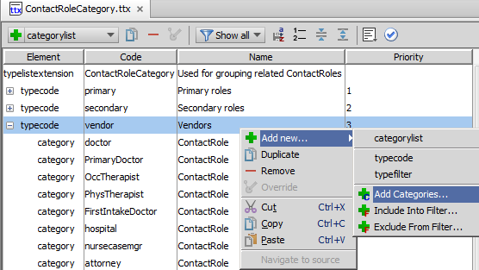
Contact role categories
This typelist exists purely for filtering the contacts list view
Notes:
To assign a ContactRole typecode to a given category:
Go to the ContactRoleCategory typelist.
Select the desired category typecode.
Add the desired role using the right-click context menu shown above.

Slide 30
Role constraints
role: driver
role: primary doctor
role: driver
Attorney
An attorney who's the primary doctor?
role: driver
Three people were driving the car?
Role constraints prevent users from assigning roles to contacts in a manner that does not make business sense

Slide 31
Two types of role constraints
role: primary doctor
Doctor
role: claimant
exposure (exactly 1)
role: primary doctor
Attorney
role: claimant
policy (0)
Contact role type constraint
Which subtypes can have this role?
Entity role constraint
Which types of entity can own the role?
How many contacts can you have with role?
Notes:
A contact role type constraint can be thought of as a "which subtype" constraint. It identifies the subtype for which a given role is allowed. In the example above, the role primary doctor can be held by anyone of the subtype doctor but not by someone of the subtype attorney.
An entity role constraint can be thought of as both a "which owner" constraint and a "how many" constraint. It identifies which entities can be the owner of a role, and how many contacts can be associated with that entity with that role (exactly one, at least one, at most one, or unlimited). In the example (on the right) above, an exposure (for a non-workers' comp claim) must have exactly one claimant. A policy cannot have any claimants.

Slide 32
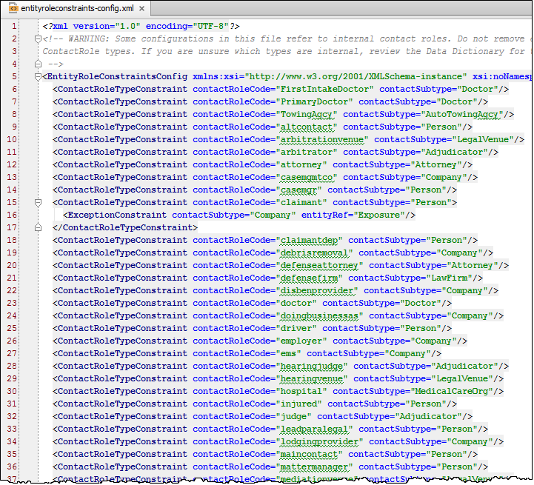
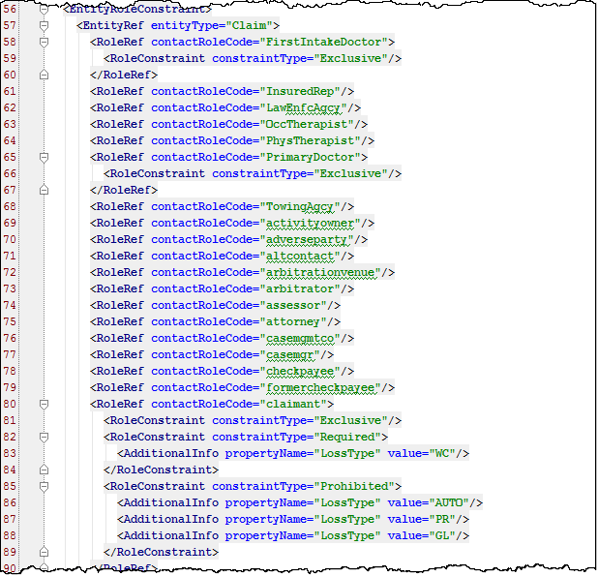
Specifying role constraints
Both type are specified in entityroleconstraints-config.xml
role: primary doctor
Doctor
Contact role type constraints
role: claimant
exposure (exactly 1)
Entity role constraints
Notes:
The following sections of this lesson discuss how to configure each type of role constraints in entityroleconstraints-config.xml. The file starts with a list of all Contact Role Type constraints, then, about line 56, lists all Entity Role constraints.
Recall you can use CTRL+SHIFT+N to search for and open xml files by name in Studio for editing.

Slide 33
Lesson outline
Contact basics
Contact roles
Categorizing contact
Contact role configuration
Contact role type constraints
Entity role constraints

Slide 34
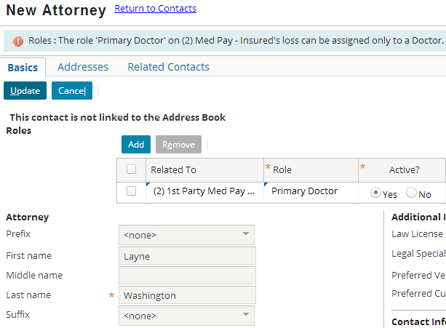
Contact role type constraints in the user interface
role: primary doctor
Attorney
Prevents user from assigning given role to contact of given subtype
Role appears in dropdown, but attempts to save contact fail
Notes:
The base application contains a role constraint that states "The role of primary doctor can only be assigned to a contact of subtype 'doctor'." In the screenshot above, the user is attempting to assign the role of primary doctor to a contact of subtype 'attorney'. The constraint prevents the role assignment from occurring, and the error message details the reason.

Slide 35

Contact role type constraint configuration
AutoTowing Agcy
Doctor
roles: first intake doctor primary doctor
role: towing agency
Identifies a contact role (such as "PrimaryDoctor") and the base subtype which is valid for that role (such as "Doctor")
Children subtypes of the base subtype also valid
In most cases, only one base subtype valid for each role
Given base subtype may be valid for multiple roles
Notes:
If a contact role does not have any ContactRoleTypeConstraint defined, then the role may be any contact subtype.
Children of the base subtype are also valid. For example, if the base subtype is “Person”, then a contact whose subtype is “Doctor” would also be valid.
Typically a contact role should have only one possible contact subtype but in the base application there is one exception:
<ContactRoleTypeConstraint contactRoleCode="claimant" contactSubtype="Person">
<ExceptionConstraint contactSubtype="Company" entityRef="Exposure"/>
</ContactRoleTypeConstraint>
This is the special case that occurs only once in the base application. In the example above, claimant is always of subtype person, except when on exposure, it can also be of subtype company. So a claimant must be either a Person or, if being assigned to an exposure, a Person or Company.

Slide 36
Lesson outline
Contact basics
Contact roles
Categorizing contact
Contact role configuration
Contact role type constraints
Entity role constraints

Slide 37
Entity role constraints
For a given type of "related to" entity, a role can be:
Not allowed
Unlimited
- Limited to at least one, at most one, or exactly one contact
reporter
claimant
driver
claim (exactly 1)
policy (0)
claim* (0)
policy (0)
claim, exp., policy, injury in., property in. (0)
exposure (0)
incident (0)
exposure (exactly 1)
incident (0)
vehicle in. (up to 1)
Notes:
With regards to the "reporter" role:
A claim must have exactly one reporter.
A policy, exposure, or incident cannot have a reporter.
With regards to the "claimant" role:
An exposure must have exactly one claimant.
A claim*, policy or incident cannot have a claimant.
With regards to the "driver" role:
A claim, policy, exposure, injury incident or property incident cannot have a driver.
A vehicle incident can have up to one driver.
*The behavior of the claimant constraint actually varies based upon the loss type. For auto, property, and general liability claims, the claimants do not exist at the claim level. You cannot add a contact as a claimant until you have exposures, and the "claimant" contacts are owned by the exposures, not by the claim itself. For workers' comp claims, there is always a single claim, regardless of the number of exposures. Therefore, a workers' comp claim can (and must) own a contact with the role of claimant.

Slide 38
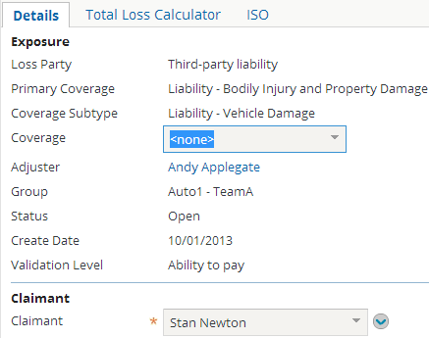

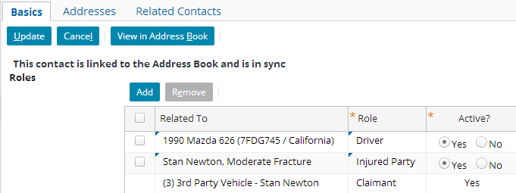
Entity role constraints in the UI (1)
If role is required:
Contact must be specified during object creation
Role can be shifted between contacts, but must always exist
claimant
exposure (exactly 1)
Notes:
In the example above, the role "claimant" is required for the exposure entity. (Every entity must have exactly one claimant.) Therefore:
During the creation of the exposure, the Claimant field is required. The selected contact is added to the claim with the role "claimant" for the given exposure.
Once created, the row in the Roles list view for the exposure claimant remains read-only, even if the list view itself is in edit mode.
From the Parties Involved screen (shown in the bottom screenshot), you cannot modify a role that is required (such as the "Reporter" role shown above (middle screenshot). However, there may be other places in the application where you could move the role from one contact to another. (For example, the Loss Details screen has a "Reported By" widget that can be used to select a different contact to have the role of reporter.)

Slide 39
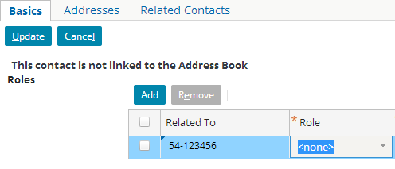
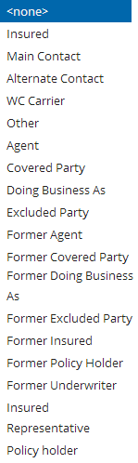
Entity role constraints in the UI (2)
claimant
(policy)
claimant
policy (0)
If role is not allowed:
Does not appear in dropdown once Related To entity is selected
Notes:
In the example above, the role "claimant" is not allowed for the policy entity. (Every entity must have no claimants.) Therefore:
When you select a policy in the Related To dropdown, the "Claimant" role is hidden from the Role dropdown.
If you select "Claimant" from the Role dropdown and then select a policy in the Related To dropdown, the Role dropdown is reset to "none selected".

Slide 40
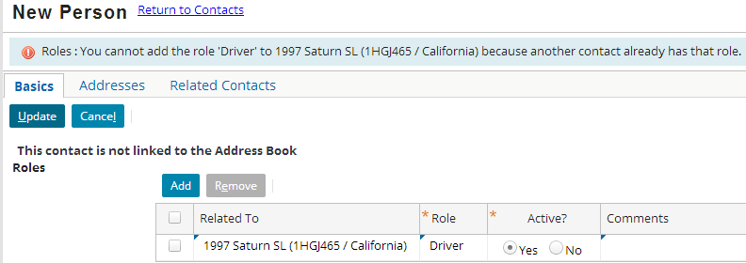
Entity role constraints in the UI (3)
vehicle incident (up to 1)
driver
If role is limited to at most one contact and existing contact has role, then error message displays when user attempts to give role to additional contact
Notes:
In the example above, there is already a contact associated with the claim with the role of "driver" for the 1997 Saturn SL incident. Therefore, a second contact cannot be given that same role on that same incident.

Slide 41
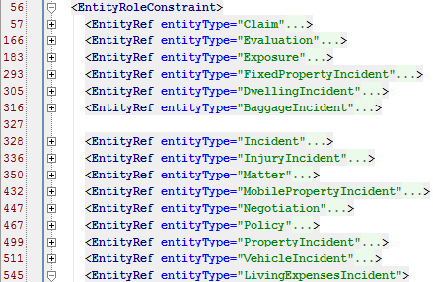
Entities that can be role owners
List is self-documented in entityroleconstraints.xml file
List is not extendable
From entityroleconstraints.xml
Claim | Matter
Evaluation | MobilePropertyIncident
Exposure | Negotiation
FixedPropertyIncident | Policy
DwellingIncident | PropertyIncident
BaggageIncident | VehicleIncident
Incident | LivingExpensesIncident
InjuryIncident

Slide 42
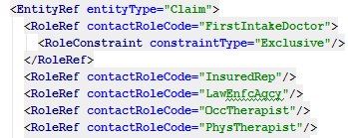
Entity role constraint configuration (unrestricted)
Entity role constraint lists type of entity and roles allowed for that entity
RoleRef (without any child tags) identifies that any number of contacts (including 0) can have role on instance of that entity
For example, claim can have 0 to many physical therapists, occupational therapists, law enforcement agencies, and insured representatives
Notes:
The examples shown in this lesson are taken from the base application and not configured differently.

Slide 43
Entity role constraint configuration (restricted)
Role constraint modifies "0 to many" default cardinality
Can be set to:
Exclusive - At most one (0 or 1)
Required - At least one (1 to many)
Prohibited - None (0)
Notes:
In the example above, a claim is not required to have a FirstIntakeDoctor, but it can have up to one FirstIntakeDoctor.

Slide 44

Role refs with multiple role constraints
A RoleRef can have multiple role constraints, which typically occurs when combining...
Exclusive (at most one), and
Required (at least one)
...to require exactly one contact with the role
Notes:
In the example above, a Policy must have exactly one contact with the role insured. Several lines have been omitted from the screenshot (in between the EntityRef and the RoleRef) for instructional purposes and for legibility.

Slide 45
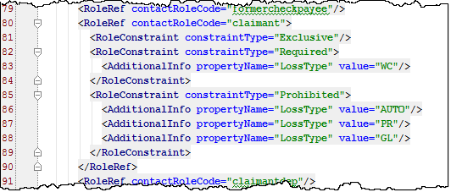
Conditional role constraints
RoleConstraint can have AdditionalInfo child, which specifies entity field and value
Constraint applies only when field has that value
Notes:
In the example above, the role "claimant" is exclusive on a claim and required for a claim if the claim's loss type is "WC" (workers' comp). This is because all exposures in a workers' comp claim have a single claimant, and it makes the most sense to track the claimant at the claim level. The role "claimant" is prohibited for a claim if the claim's loss type is "AUTO", "PR" (property), or "GL" (general liability). This is because each exposure in these types of claims can have a different claimant. Therefore, the "claimant" role is owned by the exposures and is not owned at the claim level itself. (If it were owned at the claim level, a user could create a claimant that was not assigned to any exposure, which users shouldn't be allowed to do.)
If a RoleRef has any conditional RoleConstraints, then it must have a "default" unconditional RoleConstraint as well. This is required for internal processing. The unconditional RoleConstraint should be at the most relaxed level possible, which typically is "ZeroToMany". In the example above, line 81 is the default RoleConstraint. If the instance of ClaimCenter has only four possible loss types (WC, AUTO, PR, and GL), then the role constraint will never be enacted. Nevertheless, an unconditional role constraint is still required.
Several lines have been omitted from the screenshot (in between the EntityRef and the RoleRef) for instructional purposes and for legibility.

Slide 46


Contact role functions
For "Related" entities, function created for each role entity can own
Appears in data dictionary like a field, but:
Always singular (even when many contacts can have the role)
Sometimes written with a lowercase initial letter
Always a virtual property, not a table column
Returns the contact with the role "reporter" for the claim
Returns the set of persons with the role "witness" for the claim

Slide 47
Review: Steps to create a new contact role
Edit ContactRole typelist with new role
Edit ContactRoleCategory typelist
Only if you want this role filterable in parties involved listview entries
Edit entityroleconstraints-config.xml
Add contact role type constraint to restrict type of contact allowable for this role
Add entity role constraints to enable role on entities
Add further constraints to make role exclusive, required, or prohibited

Slide 48
Lesson objectives review
You should now be able to:
Describe the ways in which contacts are categorized
Describe and configure contact roles
Configure contact role type constraints
Configure entity role constraints

Slide 49
Review questions
What is the ContactRoleCategory typelist used for?
Acme Insurance has requirements around contacts who are inspectors. For each requirement, identify if this could be implemented through a subtype, a contact role type constraint, or an entity role constraint:
A property incident can have at most one inspector, but it is not required.
An inspector must have a license, and Acme must know the date the license was issued.
You cannot assign an inspector to a policy.
The inspector role cannot be assigned to a contact whose subtype is doctor or lawyer.
The Claim entity has a listing in the data dictionary called "reporter". It is not a data field. What is it?
Notes:
Answers
1. The typelist is used for the contact filter which appears at the top of the Contacts list.
2. a) Entity role constraint
b) Subtype
c) Entity role constraint
d) Contact role type constraint
3. It is a derived property that returns the contact who has the role "reporter" on the claim.

Slide 50
Notices
Copyright © 2001-2014 Guidewire Software, Inc. All rights reserved.
Guidewire, Guidewire Software, Guidewire ClaimCenter, Guidewire PolicyCenter, Guidewire BillingCenter, Guidewire Reinsurance Management, Guidewire ContactManager, Guidewire Vendor Data Management, Guidewire Client Data Management, Guidewire Rating Management, Guidewire InsuranceSuite, Guidewire ContactCenter, Guidewire Studio, Guidewire Product Designer, Guidewire Live, Guidewire DataHub, Guidewire InfoCenter, Guidewire Standard Reporting, Guidewire ExampleCenter, Guidewire Account Manager Portal, Guidewire Claim Portal, Guidewire Policyholder Portal, ClaimCenter, BillingCenter, PolicyCenter, InsuranceSuite, Gosu, Deliver Insurance Your Way, and the Guidewire logo are trademarks, service marks, or registered trademarks of Guidewire Software, Inc. in the United States and/or other countries.
All other trademarks are the property of their respective owners.
This material is confidential and proprietary to Guidewire and subject to the confidentiality terms in the applicable license agreement and/or separate nondisclosure agreement.
This file and the contents herein are the property of Guidewire Software, Inc. Use of this course material is restricted to students officially registered in this specific Guidewire-instructed course, or for other use expressly authorized by Guidewire. Replication or distribution of this course material in electronic, paper, or other format is prohibited without express permission from Guidewire.
Guidewire products are protected by one or more United States patents.

